Slide 1
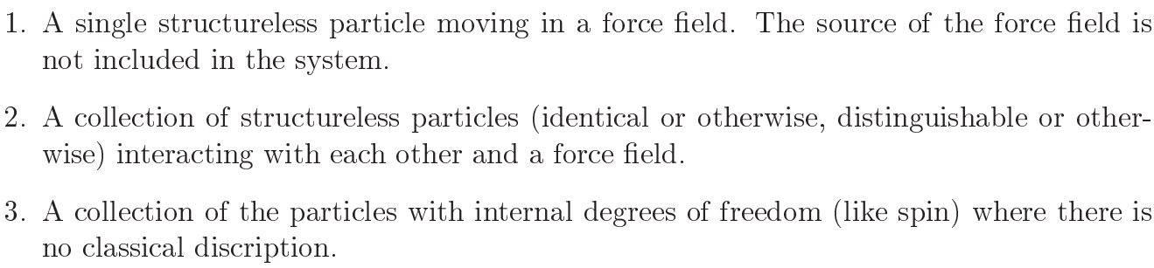
The Quantum System
By quantum system, one means one of the following cases:

Slide 2
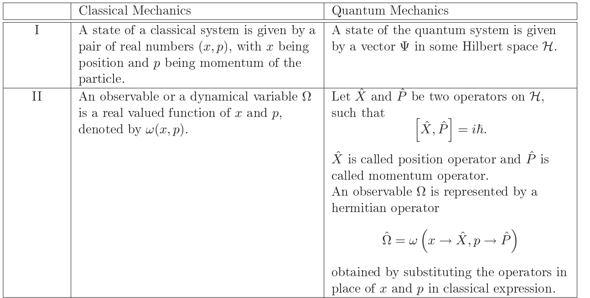
The Postulates of Quantum Mechanics

Slide 3
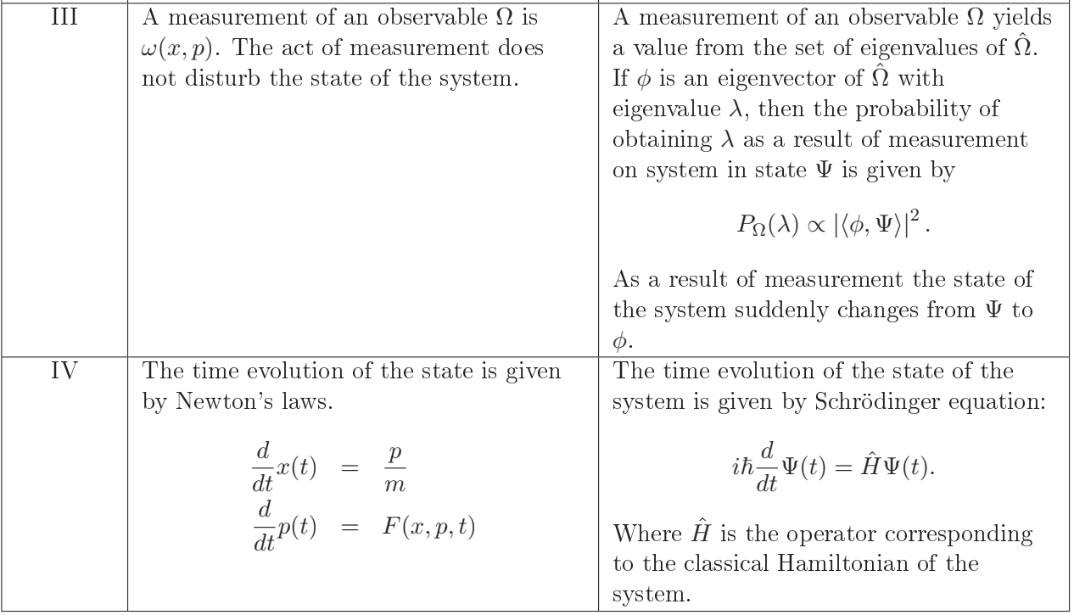

Slide 4
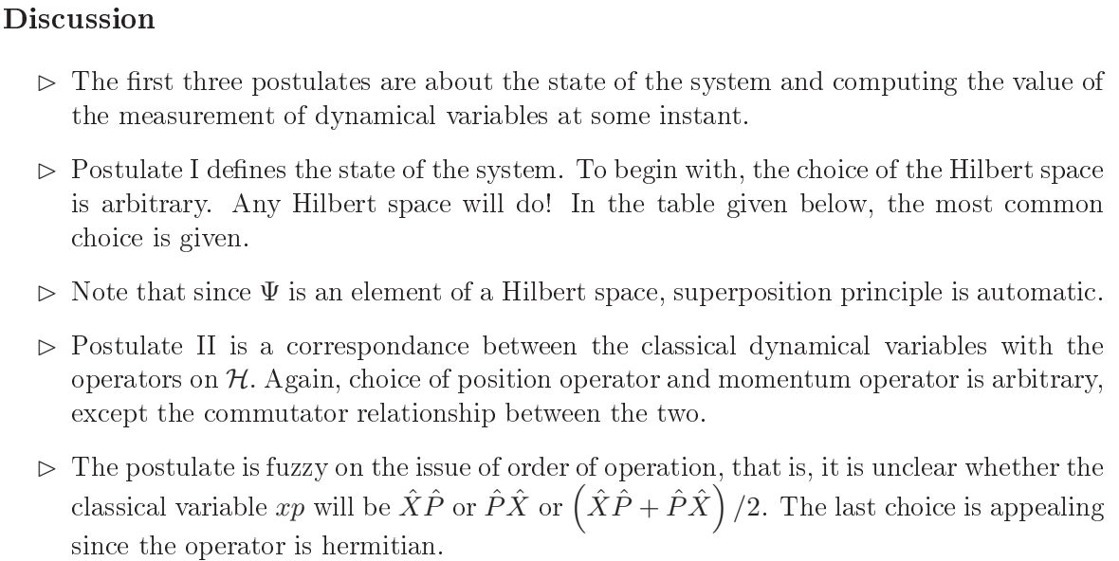

Slide 5
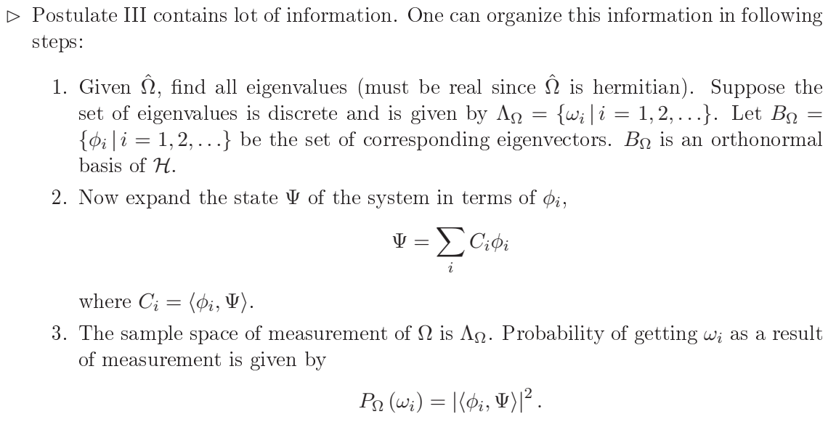

Slide 6
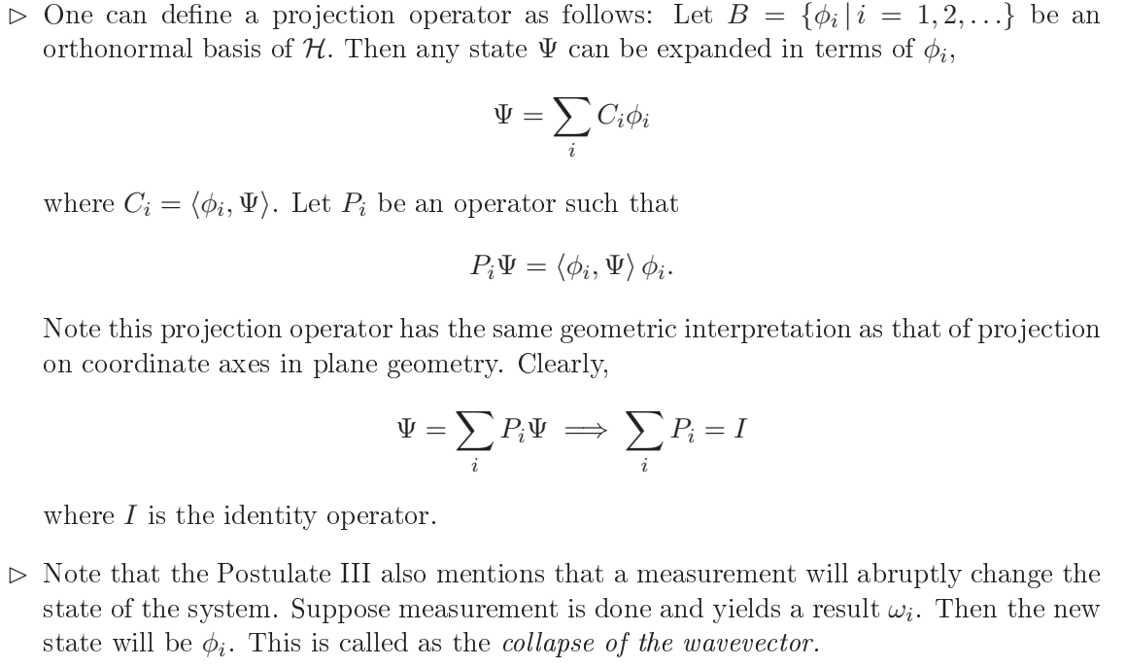

Slide 7
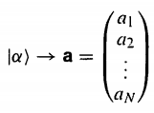
Formalism
Quantum theory is based on two constructs: (i) Wave functions and (ii) Operators.
The state of a system is represented by its wave function, observables are represented by operators. Mathematically the wave function satisfy the defining conditions for abstract vectors, and operators act on them as linear transformations.
In an n-dimensional vector space, the vector $|α>$ is represented as

Slide 8


The collection of all functions of x constitutes a vector space, to represent a physical state, the wave function must be normalizable
The set of all square-integrable functions on a specified interval
Constitute a smaller vector space. Called Hilbert space, in quantum mechanics the wavefunctions live in Hilbert space.
In mathematics, Hilbert spaces (named after David Hilbert) allow generalizing the methods of linear algebra and calculus from (finite-dimensional) Euclidean vector spaces to spaces that may be infinite-dimensional. Hilbert spaces arise naturally and frequently in mathematics and physics, typically as function spaces. Formally, a Hilbert space is a vector space equipped with an inner product that defines a distance function for which the space is a complete metric space.

Slide 9


The inner product of two functions $f(x)$ and $g(x)$ is defined as
Where,

Slide 10



The expectation value of an observable Q(x,p) can be expressed very neatly in inner-product notation as

Slide 11


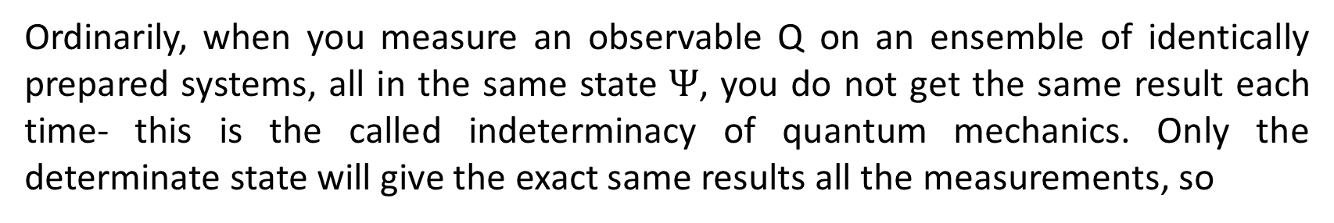
Ordinarily, when you measure an observable Q on an ensemble of identically prepared systems, all in the same state $Ψ$, you do not get the same result each time- this is the called indeterminacy of quantum mechanics. Only the determinate state will give the exact same results all the measurements, so
The only function whose inner product with itself vanishes is 0, so

Slide 12





Slide 13
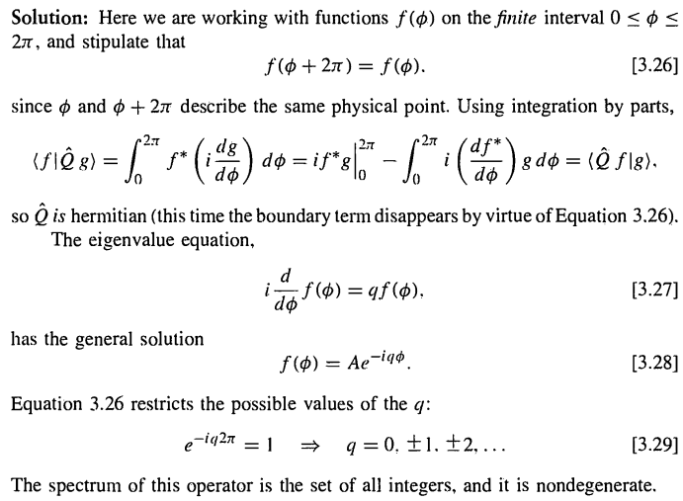

Slide 14
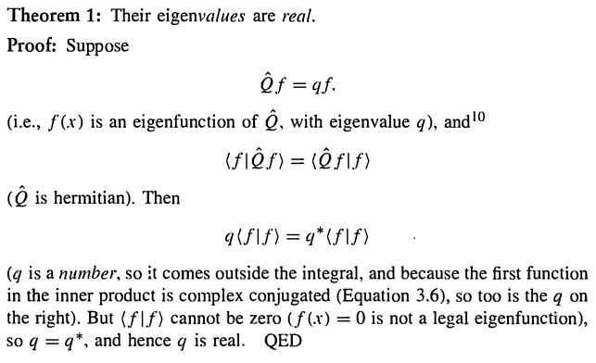

Properties of eigenfunction of Hermitian operator

Slide 15
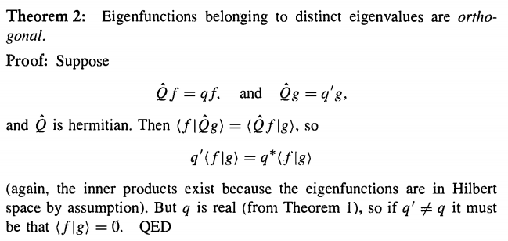
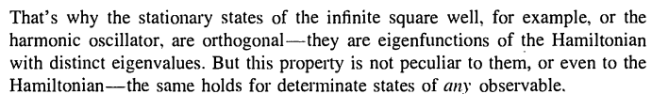

Slide 16
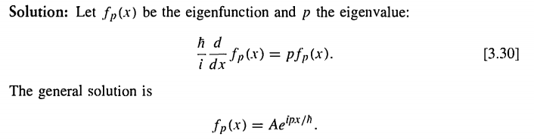
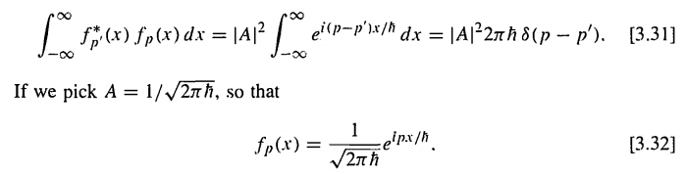
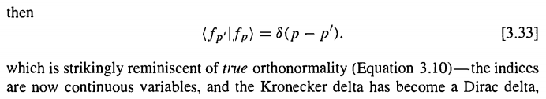

Slide 17
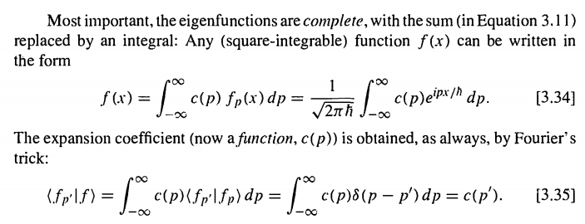

Slide 18
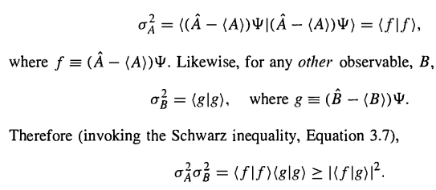
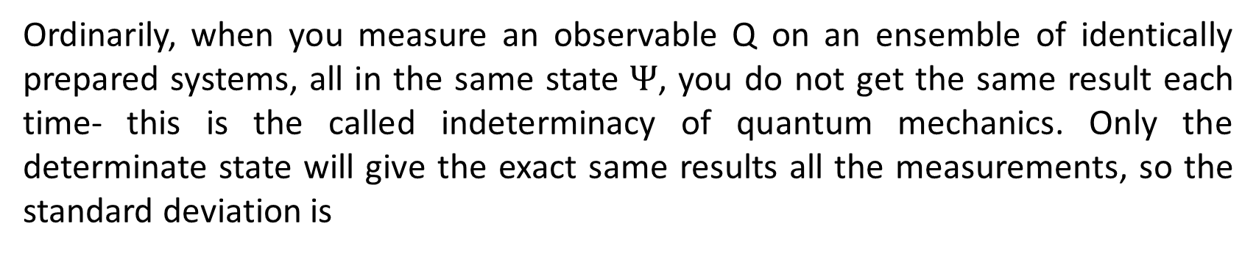
Generalized Uncertainty Principle
Ordinarily, when you measure an observable Q on an ensemble of identically prepared systems, all in the same state $Ψ$, you do not get the same result each time- this is the called indeterminacy of quantum mechanics. Only the determinate state will give the exact same results all the measurements, so the standard deviation is
So, for any observable $\hat{A}$ we can write the deviation as

Slide 19
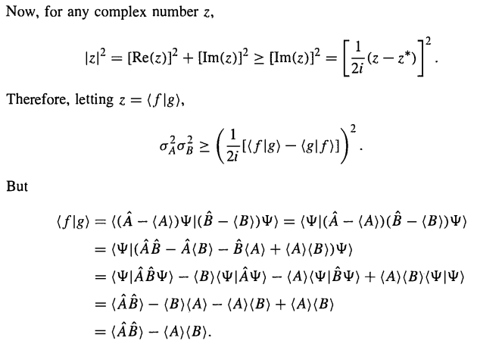

Slide 20

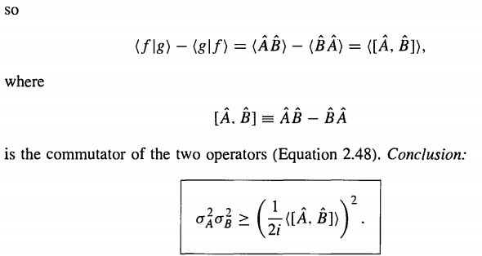
This is the general uncertainty relation

Slide 21
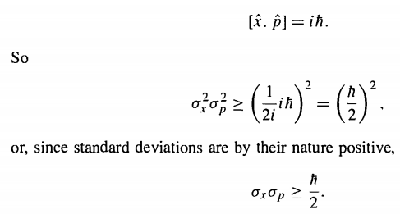
Now if we choose $\hat{A}$ as the position operator and $\hat{B}$ as the momentum operator, then the commutation relation is
This is the Heisenberg uncertainty principle

Slide 22
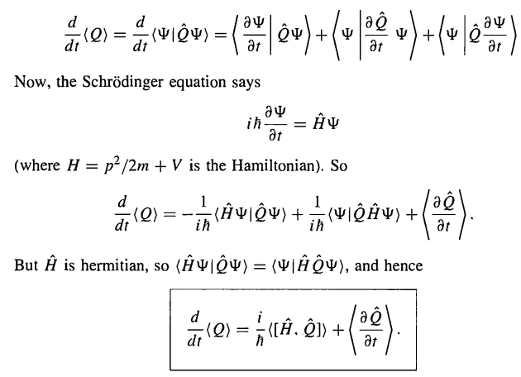

Time Derivative of the expectation value of an observable
Let us consider some observable $Q(x,p,t)$

